Slide 1
Introduction to HTML and CSS
Moving a bit beyond “Hello World”

Slide 2
Today
Review
An overview of the basics of HTML and CSS
  How the web works… an introduction.
Activity: Let’s expand our website
By the end of today, you’ll know a standard means of organizing a website on a server, gain experience working with our IDE, ‘deploy’ a local testing server, create and reference CSS files.

Slide 3
Announcement: We’ll introduce some javascript basics on Friday, rather than additional CSS time.

Slide 4
(Hopefully) Helpful Review

Slide 5
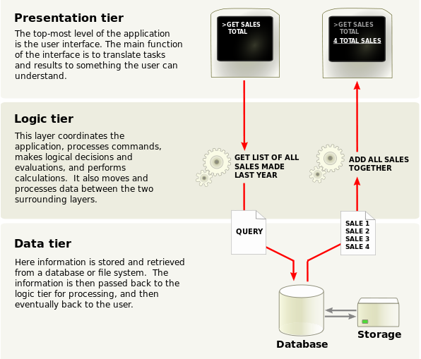
Three ‘core’ concepts of the web
Data Transmission Protocols
  TCP/IP, HTTP, HTTPS, FTP, etc.
Representation Formats
  HTML, CSS, XML, etc.
Addressing Standards
  URI, URL
Notes:
These are separate concepts. Walk through the left.
On the right:
1. Presentation tier - contents in browsers - html, js, and css - might use angular or react or whatever.
2. Application layer - processes the logic for the application - back end server computation
3. Data layer - back-end - mongo, sql, etc.
Example:
Movie times in our area on the web.
Presentation has fields that you enter the movie name and zip code.
Passed to the application layer that formats this as a query and hits the database
Database passes back the result, application formats it into a web page (or passes it along as is for the web page to format)
The page loads or updates with the formatted data.
Separation here is important - can update without taking whole stack down, can isolate issues, can scale up and out. Adds reliability.
Three tier architecture was the standard for client-server architecture for decades, but more recently many are moving to more cloud-native solutions like containers and microservices; however, it’s still useful to think through.

Slide 6
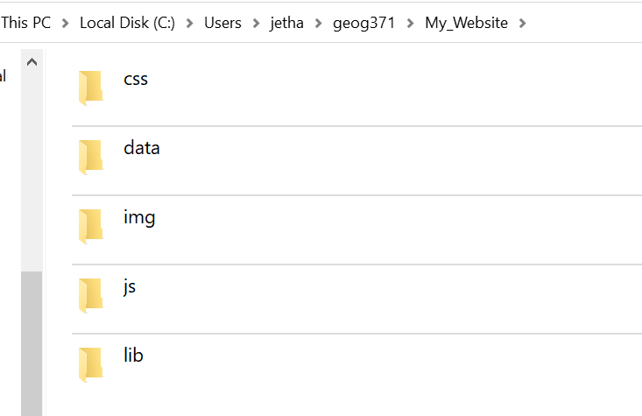
Some helpful terms
HTML - HypterText Markup Language
  Primary language for ‘the web’
  Invented by Tim Berners-Lee in 1989 in the particle physics CERN laboratory
  First graphical browser in 1992
CSS - Cascading Style Sheet
  Defines the appearance of a website
  Allows separation of content and presentation!
Javascript
  High-level language that runs in a web browser
  Dynamic typing, object oriented… multi paradigm support
Notes:
This is the key for us. We can talk more about the others, and you should read/learn about them as you encounter them. But, for web mapping…

Slide 7
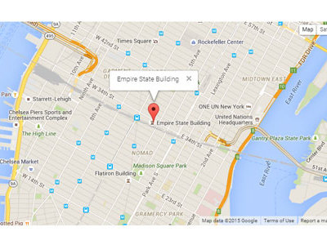
The story
In 2005 Google releases their version of Google Earth
In June, they release the Google Maps API
This is one of the first major implementations of geospatial “Web 2.0”
Notes:
Make note: An API stands for “Application Programming Interface” and it’s a way for you to ask for and receive resources and information from programs outside of your own.
We’ll go over what these are in detail, but for right now, it’s important to know that what Google did was allow anyone to embed maps into their websites by making a call to their servers.

Slide 8
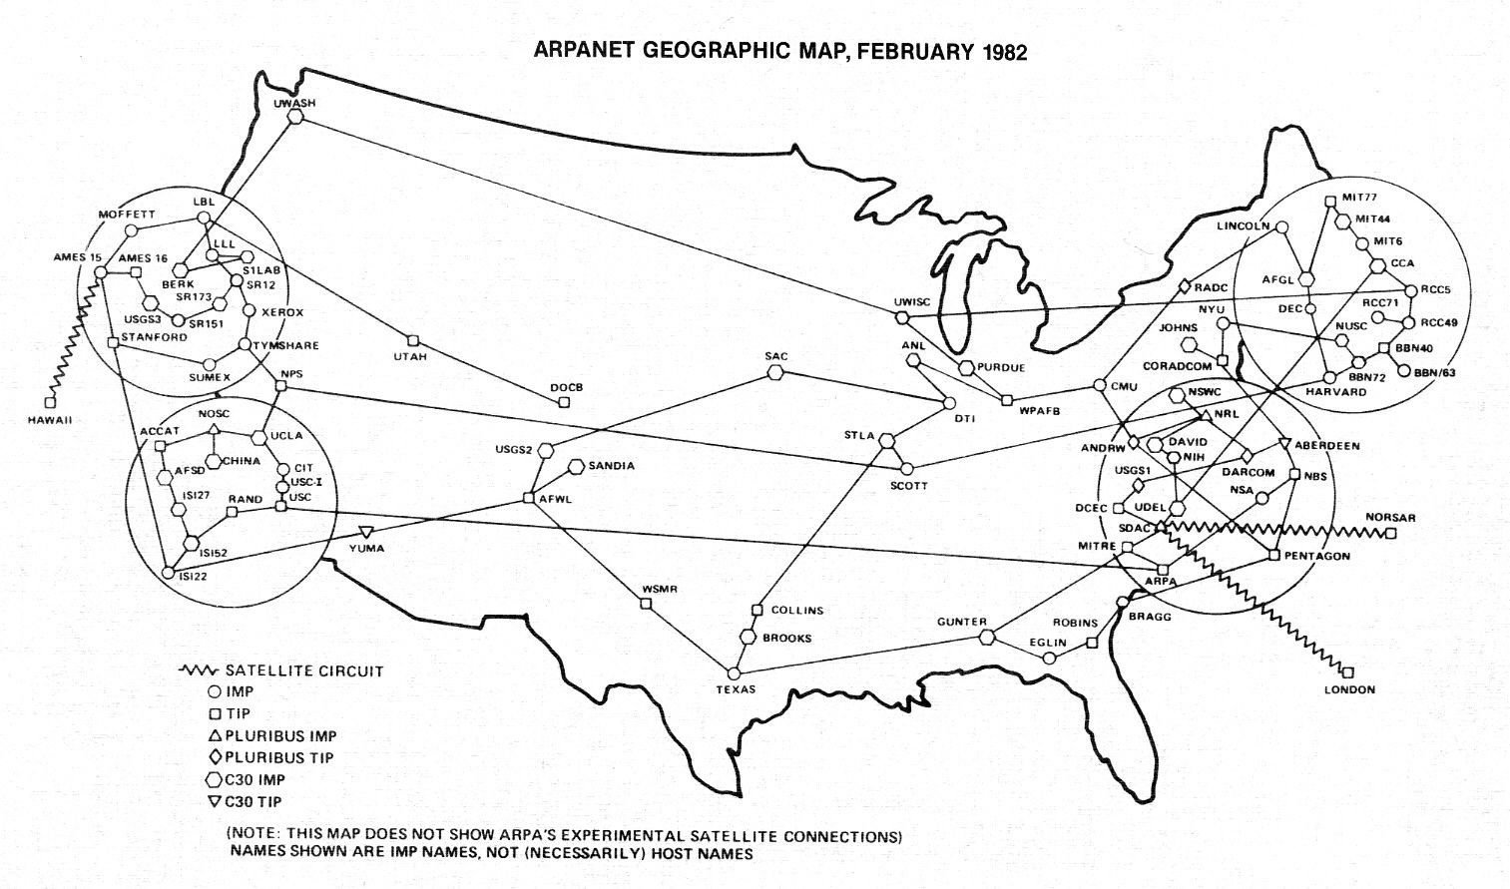
But it’s always already longer…
Google acquires Keyhole in October of 2004
Keyhole was supported by In-Q-Tel, the CIA’s venture capital firm (Mapbox was similarly supported)
Keyhole relied on TerraVision which was a game development firm in the 1990s
Navstar 1 launched in 1978
TRANSIT was launched in 1959
Notes:
Networks build on networks.
Transit was the first satellite navigation network and was used by the navy heavily to direct its polaris ballistic missile subs during the cold war.
If have time, tell story about GPS and Bill Clinton

Slide 9
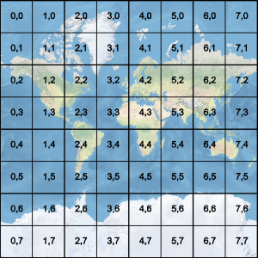
Raster Tiles
Still the most common (although changing)
Map stylings are pre-assembled and broken apart into individual tiles
May appear to be points, lines, or polygons - but those are ‘baked’ into static digital images
One advantage: fast loading times

Slide 10
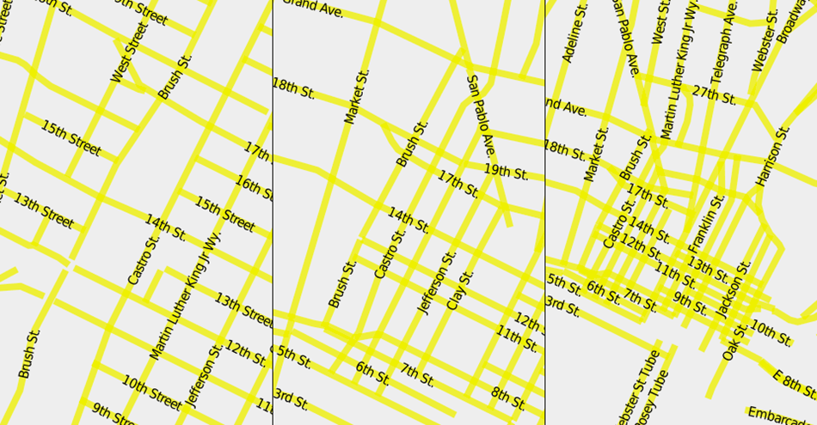
Vector Tiles
Vector data is broken into tiles
All the benefits and liabilities of vector data
  Less pronounced stepping through scales
  Data is repositioned according to rules as you move across scales (rather than pre-packaged at various levels)
Google Maps, Apple Maps, Mapbox, and even OpenStreetMap are all implementations of vector tiles in various ways
Notes:
Note: everyone has experienced that jumble of labeling rules working at one scale and not at another. One of the major skills we’ll be working on throughout this course is designing robust maps that don’t end up looking like on the right. There are various approaches to this (including just using raster tiles).

Slide 11
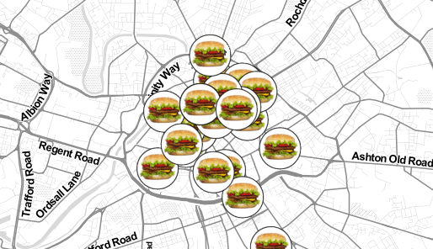
A common combination
A raster ‘base map’
Vector data on top
Roth et al. call this ‘hamburger cartography’
  Literally no one else does.
We’ll be working on how you design ‘base maps’ later in the quarter with Mapbox Studio
Notes:
Image courtesy of Andrew Hill on twitter - Andrew Hill on X: "I don't get to see burger icons everyday :) http://t.co/6AgMnpeJJR http://t.co/B7122iHX3r" / X (twitter.com)

Slide 12
Let’s talk HTML
HyperText Markup Language is the standard markup language for web browsers.
Websites usually consist of:
  HTML tell browsers what elements of a webpage go where
  CSS handles what those elements look like
  Javascript handles dynamic aspects
A common set up for a website’s file structure is to the right

Slide 13

HTML, CSS, and Javascript - a ‘cheat sheet’
Notes:
HTML defines the structure of the content. CSS defines the look of it. Javascript (or another language) allow for dynamic actions.

Slide 14
https://www.oregonstate.edu
http:// - this is the scheme. It tells the browser how to connect to the server.
www.oregonstate.edu - this is the domain name. It points to a specific IP address that is resolved through a DNS lookup process
Look up the Unique Resource Identifier/Location with a DNS server (or cache) to resolve to an unique IP address.
Connect to the server using Transport Layer Security (TLS) (that’s what the s in https signals)
Send an HTTP GET request.
Display the content received.
Notes:
Reminder: All of these are being covered in fairly high level terms and with a lot of generalities. This course is not a CS one.

Slide 15
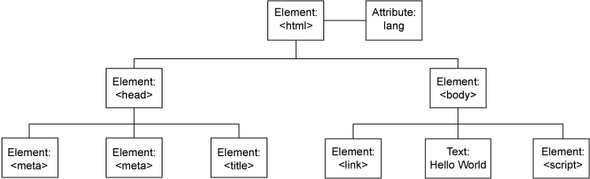
Right, but then?
The Document Object Model represents the hierarchy of elements on a web page.
Cross-platform, language-independent tree structure where each node in the tree is an object representing some part of the document (data, image, text block, etc.).
Includes all CSS styles… all javascript variables and functions, and all the HTML elements and their attributes…
Notes:
OH GEEZ. THE DOCUMENT OBJECT MODEL.

Slide 16
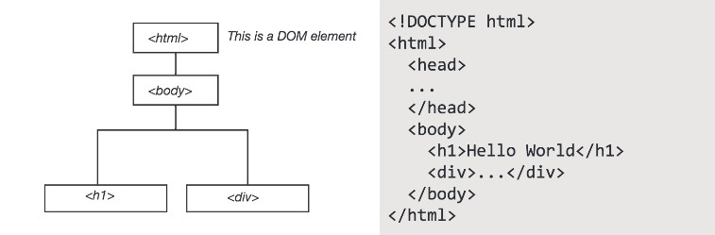
We reference objects through the DOM which allows for interactivity… and all web mapping… to take place

Slide 17
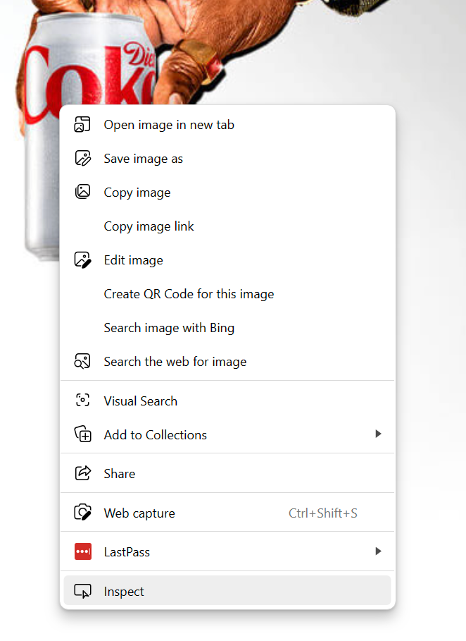
Go to any old web page
Right click (command click on a mac).
Choose “Inspect” or “Inspect Element”
What do you see?
Notes:
Joke about why I use dietcoke.com

Slide 18
Some common HTML tags
Head and Body are large containers
  <head> … </head>
    Contains meta information, styles, links, etc.
  <body> … </body>
    All document content elements usually go here!
Paragraph is for large blocks of text
  <p> My novel goes here. </p>
Images and Links are for…
  <a href=”http://joshreads.com”> A website I like </a>
  <img src=”local or link location” alt=”Description”/>
    Why do you think we use that alt there?
    You can also specify size and style in that tag.
  You can embed one in the other!
Notes:
There are a ton more. It’s worth looking up, but these will get you started.

Slide 19
Some common HTML tags
Lists can be ordered or unordered.
  Unordered:
    <ul> … </ul>
  Ordered:
    <ol> … </ol>
  In both, use:
    <li> … </li> for each entry.
Div defines a division or section of a page
  <div id=”main”> …. </div>
Tags are defined using attributes, classes, and IDs. You can use these to specify which element you want to manipulate!
  Attributes define properties of elements.
  Classes identify a group of elements that work similarly (a button)
  IDs identify unique features that you can reference and manipulate.
<div class=”header” id=”main”> … </div>
Notes:
There are a ton more. It’s worth looking up, but these will get you started.

Slide 20
Cascading Stylesheets
Styling language used to describe look and formatting of html pages.
Uses the DOM to style elements, with styles ‘cascading’ from higher elements to lower ones (down the tree structure)
  Nested elements will be styled the same as higher elements… unless you specify otherwise.
Generic format is:
[selector]{
[property] : [value];
}

Slide 21
Cascading Stylesheets
CSS can be done in-line, but it’s usually (better) to keep it in its own file.
It’s a syntax for defining how elements should be styled.
  Selector - the beginning of the ruleset, it defines which element is being styled.
  Property - what characteristic is being styled
  Value - how it’s being styled
p {color:red; font-size:20px;}
That would set all of the <p> elements to red text at 20px font size.

Slide 22
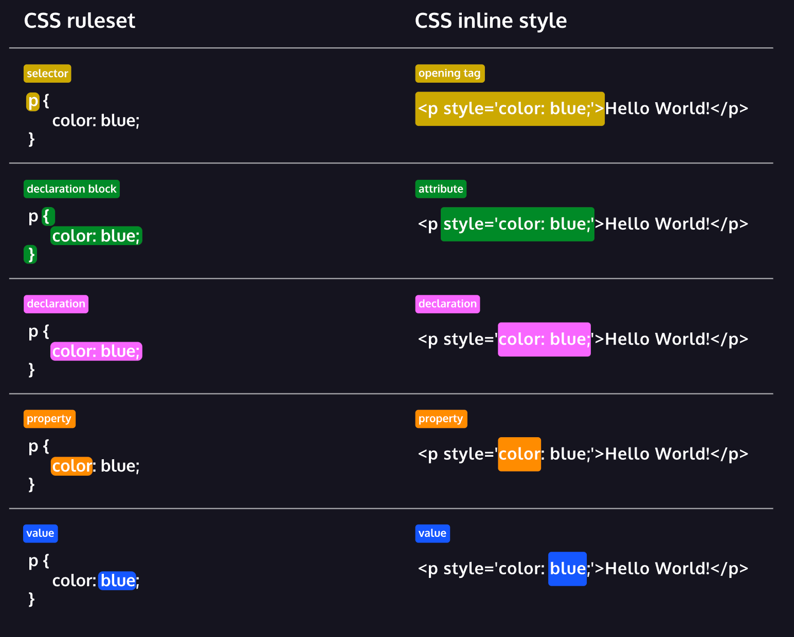
Notes:
THIS IS TAKEN DIRECTLY FROM CODEACADEMY BECAUSE IT’S WONDERFUL!

Slide 23
Cascading Stylesheets
Selectors are page elements and can be tags, ids, titles, classes, and so on.
Element:
  p{ font-size: 12;}
Class:
  .main{font-size:12;}
ID:
  #stuff{font-size:12;}
CSS defined last in a document will supercede CSS set earlier.
The more specific selector will override the less specific one
  A style set on all paragraphs will be overridden by one set on a specific ID for one paragraph.

Slide 24
Cascading Stylesheets … sheets.
The Mozilla Reference Sheet
The W3Schools reference sheet.
And the text used by a previous iteration of this course!

Slide 25
That’s an absolute ton of… stuff.
Let’s work through it using our ‘first’ web page.

Slide 26
Goals
Create a stylesheet for your website and reference it
Add multiple elements to the web page
  At least two text elements
  At least one image
  At least one link (this could be a text or image element)
Use Visual Studio Code’s LiveServer extension to make sure it works and then push it to github

Slide 27
Step 1 - Housekeeping
Either create a new repository and clone it down or use the one you used on Monday.
  Review the previous slides for reference!
  If the directory has already been initialized, great, otherwise….
  This is a good reminder that tasks build in this class
Create a new subdirectory called css
  Create an empty text file in there called style.css or main.css or…
  You could also create the other subdirectories we’ll end up using (js, img, etc.) or not!
Load up Visual Studio Code, browse to where your file is stored, and start editing…

Slide 28
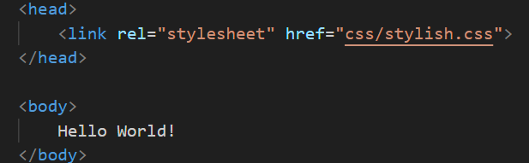
Step 2 - HTMLing
Create a <head> … </head> element.
  In it, put a reference to the .css file you created. Mine is called “stylish.css” so it looks like this:
Notes:
“Rel” tells the browser what the relationship to the file it. The link tells us it’s a link.
css/stylish.css is where it’s located (in a sub directory of the main one). It could be anywhere on the web! Go and look at other websites and see where they store them.

Slide 29
Step 2 - HTMLing
We now need to add some new elements… how about a couple of paragraphs?
  You don’t need to use <p> … look at other tags, be creative.
We also need at least one image and a link.
  I’m going to let you all review the slides, review the links, and try to come up with these on your own.
  Talk to each other!
  I’ll also be walking around to help.
Tip: You can reference local images or source them from anywhere on the internet (though, obviously, other sites will sometimes block this)
  Locally: <img src=”img/mykids.jpg”/>
  Elsewhere: <img src=”https://upload.wikimedia.org/wikipedia/commons/thumb/e/e6/Oregon_State_University_clock_tower.jpg/1280px-Oregon_State_University_clock_tower.jpg”/>
Notes:
“Rel” tells the browser what the relationship to the file it. The link tells us it’s a link.
css/stylish.css is where it’s located (in a sub directory of the main one). It could be anywhere on the web! Go and look at other websites and see where they store them.

Slide 30
Step 3 - CSSing
You’ve added elements and potentially even given them IDs.
Now you need to open up your CSS file and style them.
  Play around with different ways of doing this. Check out the reference links earlier.
  Have fun. Be creative.
When you want to see how things look, right click on the file and choose “Open with LiveServer”
Notes:
“Rel” tells the browser what the relationship to the file it. The link tells us it’s a link.
css/stylish.css is where it’s located (in a sub directory of the main one). It could be anywhere on the web! Go and look at other websites and see where they store them.

Slide 31
